Slide 1

BTech in Computer Science
And Engineering
Industry Internship Report
Cloud Virtual Internship
Presented By: Rishabh Shukla
(23SCSE1010088)

Slide 2

VIRTUAL INTERNSHIP SUMMARY
Cloud Virtual Internship
Intern Name: Rishabh Shukla
University: Galgotias University
Internship Program: Data Engineering Virtual Internship
Duration: 10 weeks( October- December 2025)
Coordinating Bodies: AICTE - EduSkills
Curriculum Provided by: AWS Academy
Grade: O

Slide 3
Introduction, Objectives, and Problem Statement
Problem Statement: The transition from localized, manual systems to a centralized, automated infrastructure.
Research Objectives: Cloud Data Management, Pipeline Automation, Data Quality And Performance
Objective of the Project: The primary objective of this Cloud Virtual Internship project was to design and implement a complete Extract, Transform, Load (ETL) pipeline utilizing modern cloud services.

Slide 4
Core Technology and Description
Curriculum Provider: AWS Academy.
Focus: Building a scalable, cloud-native Extract, Transform, Load (ETL) pipeline.
Primary Cloud Platform: Amazon Web Services (AWS).
Components | Purpose in Pipeline | Relevant AWS Services
Data Lake | Centralized, durable storage for raw and processed data. | Amazon S3 (Simple Storage Service)
Data Processing | Serverless compute environment for transformation and cleaning. | AWS Glue or Amazon EMR
Orchestration | Automating and scheduling the sequential workflow of ETL jobs. | AWS Step Functions / AWS Lambda
Metadata Management | Creating a catalog of data schemas for discoverability and querying. | AWS Glue Data Catalog
Analytics Layer | Querying structured data directly in the data lake. | Amazon Athena

Slide 5
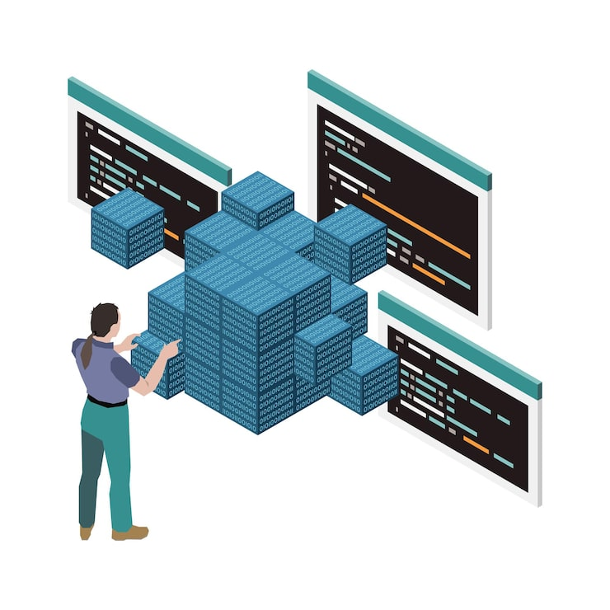
System Architecture and Methodology
General Architecture: The system utilizes a Layered Cloud Data Lake Architecture for scalability and efficiency. Raw Layer, Processing Layer and Curated Layer.
Design Phase: Mapped the logical flow of data, detailing all transformation stages and data movement within the cloud environment.
Methodology: An Agile-inspired, iterative methodology was followed, allowing for continuous integration and rapid testing of pipeline components.

Slide 6
System Implementation
Deployment: Developed Python-based automation scripts for resource extraction and loading into the storage layer.
System Automation: Utilized AWS Lambda and Step Functions to create an end-to-end, orchestrated cloud pipeline.
Key Challenges: Resolved Schema Drift issues to maintain consistency.
Mitigated Performance Bottlenecks to ensure optimal
system speed.

Slide 7
Results and Discussions
Project Outcomes:The outcome of the project was the successful design and implementation of a fully automated, end-to-end cloud pipeline using AWS Cloud services. The system effectively managed the entire data lifecycle, from raw data ingestion to transformation and modeling for analytical use.
Discussion and Significance: The significance of the Cloud-Based Smart Irrigation Prediction System lies in its ability to bridge the gap between advanced data engineering and environmental sustainability. By transitioning a local machine learning model into a scalable cloud infrastructure, the project achieves the following: Environmental Impact and Sustainability, Technological Innovation, Economic Efficiency, etc.

Slide 8

Learning Experiences
Knowledge Acquired: Cloud Data
Architecture ETL/ELT Processes
Data Modeling
Skills Learned: Technical Proficiency
Problem-Solving Process Analysis
Observed Attitudes: Professional Dependability
Attention to Detail
Adaptibility

Slide 9
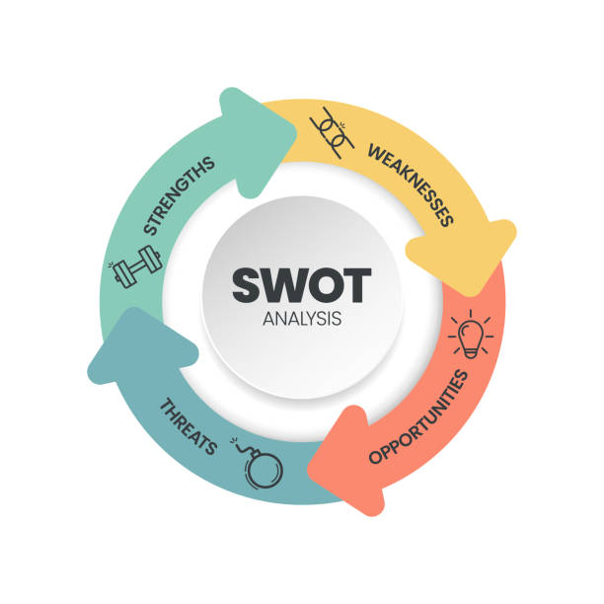
SWOT Analysis
(AICTE - EduSkills Virtual Internship Model)
Strengths: Official Recognition
Industry-Relevant Curriculum
Flexibility and Accessibility
Weaknesses: Limited Direct Mentorship
Reliance on Self-Discipline
Lack of Physical Workplace Experience
Opportunities: Skill Demand
Government Initiatives
Scalability

Slide 10

Conclusion
The industry internship focused on a Cloud-Based Smart Irrigation Prediction System was successfully completed, meeting its primary objectives of designing and implementing a scalable, automated, and robust ETL pipeline within a cloud environment. The implementation serves as a reusable and robust template for future data initiatives in the cloud. By integrating AI/ML with cloud-native tools, the project addressed critical environmental challenges like water scarcity and data inaccessibility.
Project Success: The project’s success is measured by the realization of a fully automated cloud architecture that handles the complete data lifecycle: End-to-End Automation, High Performance, Advanced Data Processing, etc.

Slide 11


Thank You!

